Slide 1
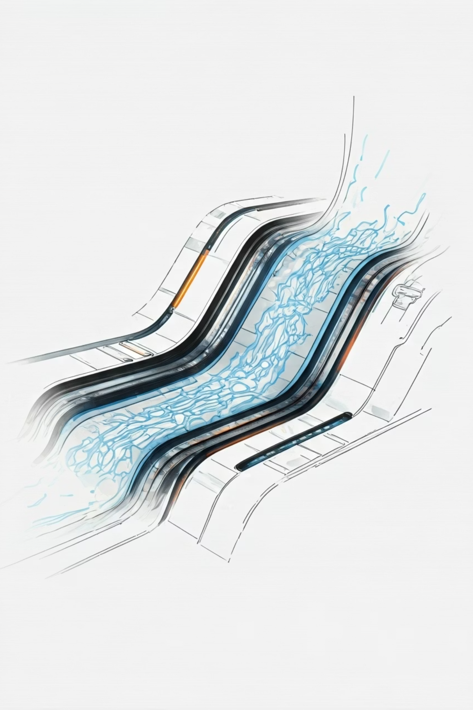
Detection of Defects in Weld X-ray's using Explainable AI
BCSE497J Project-I
Presented by: Gokularajan R. (22BDS0137), Yuva Yashvin (22BDS0177), Ashwin M Felix (22BKT0076)
Supervisor: Prof. Margret Anouncia S, VIT Vellore

Slide 2
Introduction & Motivation
Addressing the "Black Box" Problem in AI for NDT
Traditional manual inspection of weld X-rays is inherently slow, subjective, and prone to human error. While deep learning models offer remarkable accuracy, their opaque "black box" nature prevents adoption in safety-critical sectors like non-destructive testing (NDT), where trust and auditability are paramount.
Our project directly addresses this by developing a robust AI framework that marries high detection accuracy with transparent, verifiable explanations, fostering the necessary trust for industrial deployment.

Slide 3
Academic Foundations
Key Deep Learning Methods in Weld Defect Analysis
Segmentation Networks
Attention Mechanisms
U-Net variants (e.g., MAU-Net) have demonstrated high accuracy on datasets like GDXray, providing pixel-level defect identification.
Modern architectures incorporate attention layers to precisely focus on subtle or minute defects, improving detection sensitivity.
Weakly-Supervised Learning
Human-in-the-Loop XAI
Techniques like Cascade R-CNN reduce reliance on extensive, costly pixel-level annotations, streamlining data preparation.
Successful applications integrate certified inspectors to validate XAI outputs (Grad-CAM, LIME), ensuring model alignment with expert reasoning.
`

Slide 4

Current Challenges
Bridging the Critical Interpretability Gap
The interpretability gap remains a significant barrier for AI adoption in NDT.
XAI in Segmentation: While object detection benefits from XAI, explicit application of post-hoc methods like Grad-CAM in pixel-level segmentation studies is limited.
Lack of Explainability Metrics: There's a notable absence of standardized, quantitative metrics to rigorously evaluate the faithfulness and utility of XAI explanations in an NDT context.
Translational Barrier: This gap prevents the transition of highly accurate deep learning models from academic benchmarks to certified industrial practice, where trust and transparency are non-negotiable.

Slide 5
Our Mandate
Project Objectives: Accuracy, Explainability, and Auditability
01
02
03
Accurate and Granular Defect Segmentation
Implement Explainable AI for Trust
Establish a Comprehensive and Auditable Framework
Implement a deep learning model capable of precise, pixel-level segmentation of diverse weld defects, including pores and cracks.
Integrate state-of-the-art XAI techniques, specifically Grad-CAM, to render the model's decision-making process transparent and understandable to human inspectors.
Develop a "traceable-by-design" system that automatically logs all outputs (original images, segmentation masks, XAI heatmaps) to ensure every analysis is verifiable and auditable.

Slide 6
Technical Foundation
Hardware and Software Specifications
Hardware Specifications
Software Specifications
To ensure efficient training and inference, the following minimum hardware configurations are recommended:
The project will be developed within a standard, compatible software environment:
GPU: NVIDIA RTX 4070 (min 12GB VRAM) for accelerated computation.
OS: Windows operating system.
Language: Python 3.9+ for core development.
CPU: Intel i5 / AMD Ryzen 5 or better for general processing.
Core Libraries: PyTorch for deep learning, NumPy for numerical operations, OpenCV for image processing, and pytorch-grad-cam for XAI integration.
RAM: Minimum 16 GB to handle large datasets and model parameters.
Storage: Minimum 512 GB SSD for fast data access and model loading.

Slide 7



Project Management
Work Breakdown Structure & Gantt Chart
Project Planning & Research
AI System Development & Integration
Testing & Documentation
Defining scope, literature review, and initial data exploration.
Model training, XAI implementation, and framework assembly.
Validation, performance analysis, and comprehensive reporting.

Slide 8
Framework Blueprint
Requirement Analysis (SRS)
Functional Requirements (FR)
Non-Functional Requirements (NFR)
FR-1: Image Upload and Ingestion for X-ray data.
FR-3: Defect Segmentation, providing accurate pixel-level masks.
NFR-1: Trustworthiness and Reliability in safety-critical contexts.
FR-4: Defect Classification (e.g., pore, crack, inclusion).
NFR-2: Performance (End-to-end processing within seconds).
FR-6: Explainability Integration, generating Grad-CAM heatmaps.
NFR-4: Interpretability and Usability for NDT inspectors, ensuring practical adoption.
FR-8: Result Storage for a verifiable audit trail.

Slide 9
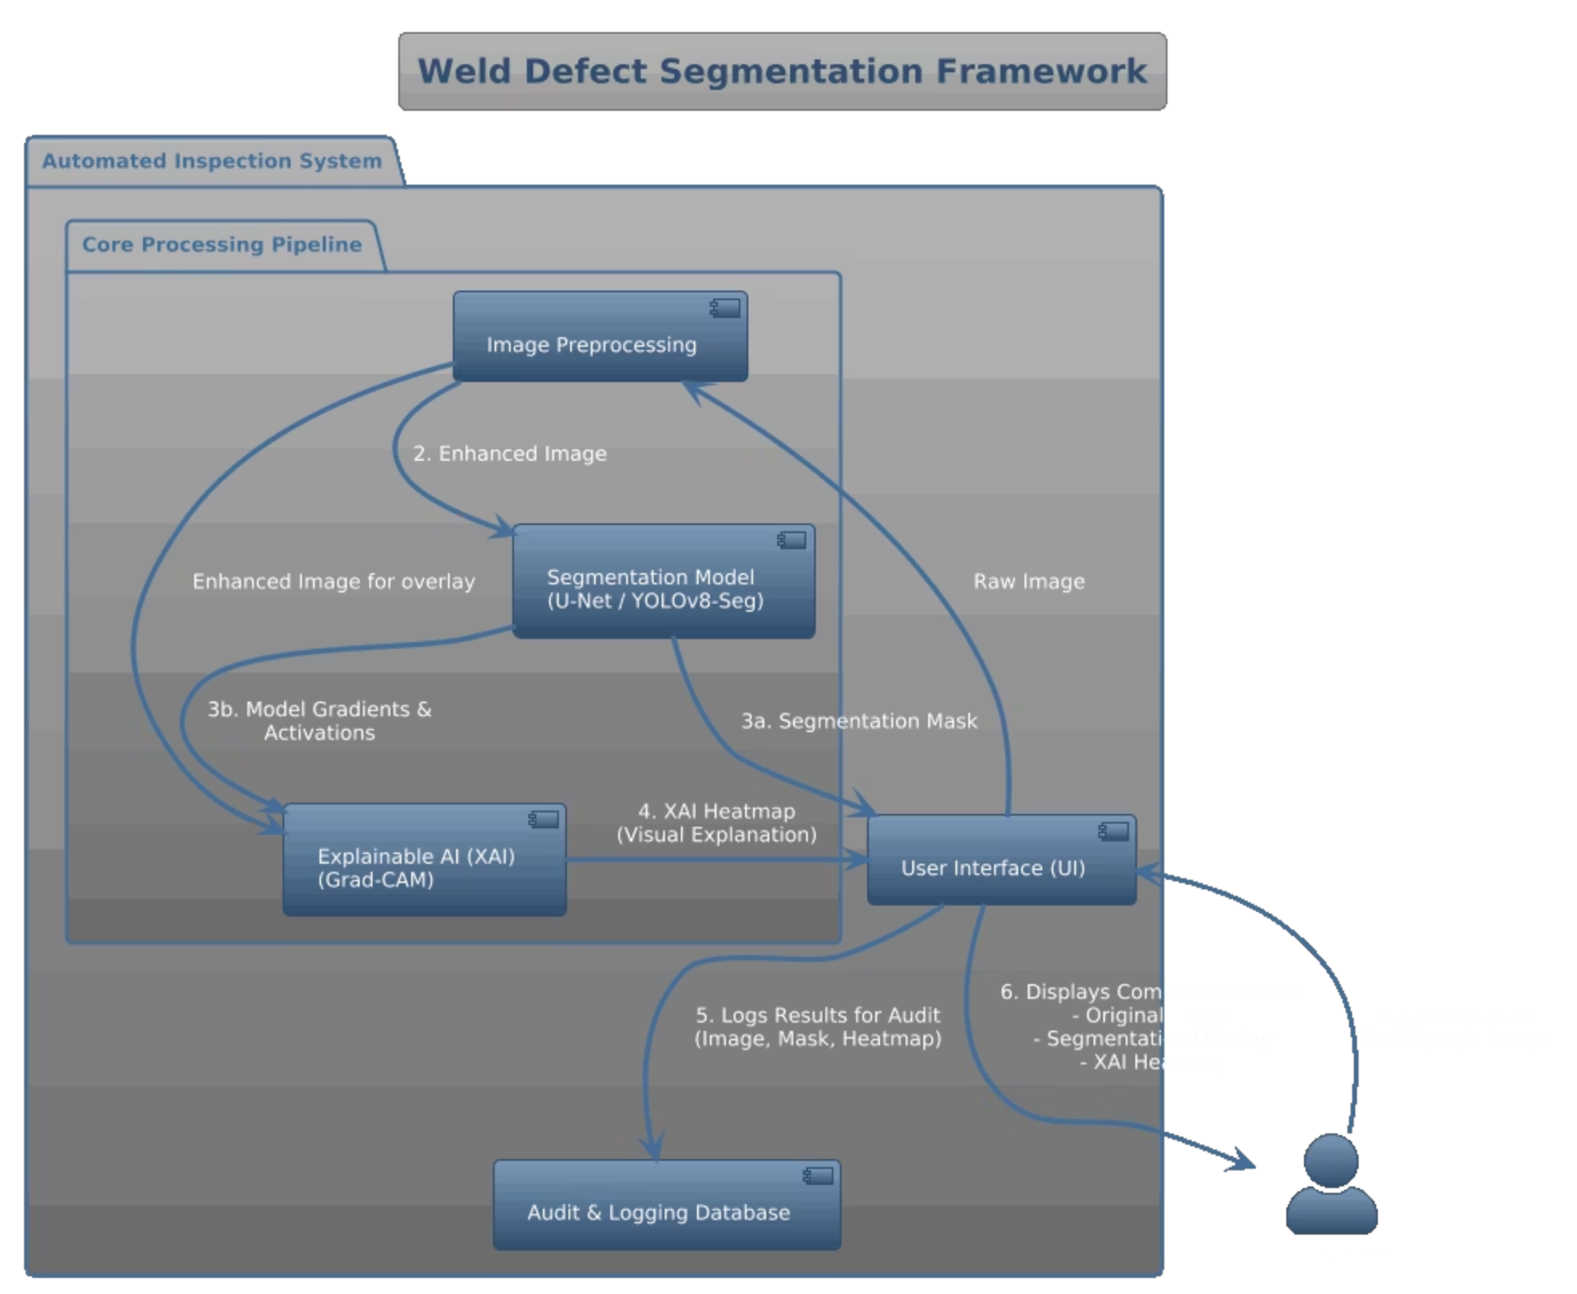




Operational Flow
System Design: Inference Workflow
An NDT inspector initiates the process by uploading an X-ray image.
The system preprocesses the image, which then feeds into the segmentation model to generate a precise defect mask.
Concurrently, an integrated XAI module creates a Grad-CAM heatmap, visually highlighting the regions influencing the model's decision.
Both the defect mask and the heatmap are logged for auditability and presented to the inspector, ensuring a fully transparent analysis and fostering trust in the AI's findings.

Slide 10
Technical Execution
Implementation Details
Our solution leverages a Python script to seamlessly integrate YOLOv8 for robust defect detection and segmentation with pytorch-grad-cam for explainability.
The custom-trained best.pt model is loaded, forming the core of our detection system.
Inference is performed to generate precise segmentation masks for all identified defects, pinpointing their exact locations and contours.
Grad-CAM is initialized, specifically targeting the final convolutional layer of the YOLOv8 model to capture high-level feature activations.
A SemanticSegmentationTarget is employed to generate a heatmap that explains the model's highest-confidence detection, providing a clear visual rationale.
The output is a comprehensive multi-panel visualization, displaying the original image with superimposed detections, the detailed segmentation mask, and the insightful XAI heatmap for transparent analysis.

Slide 11
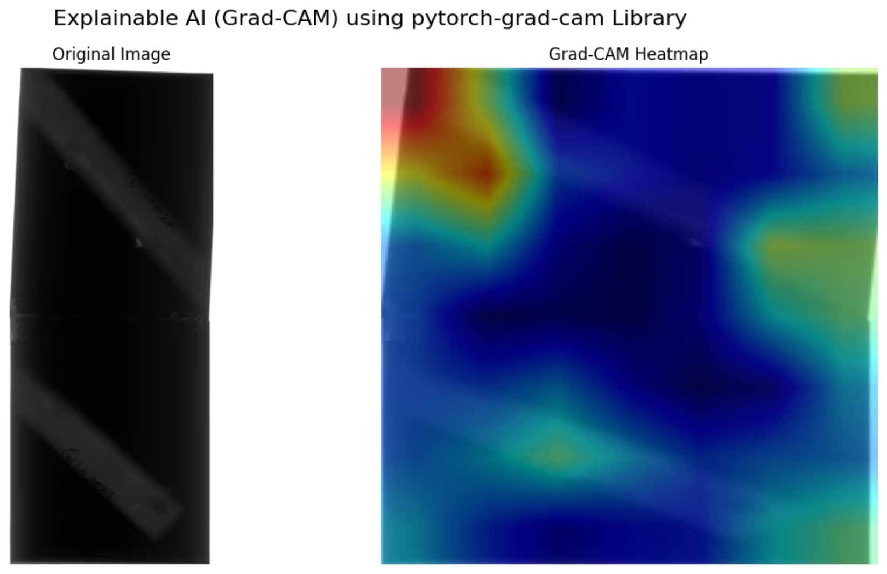
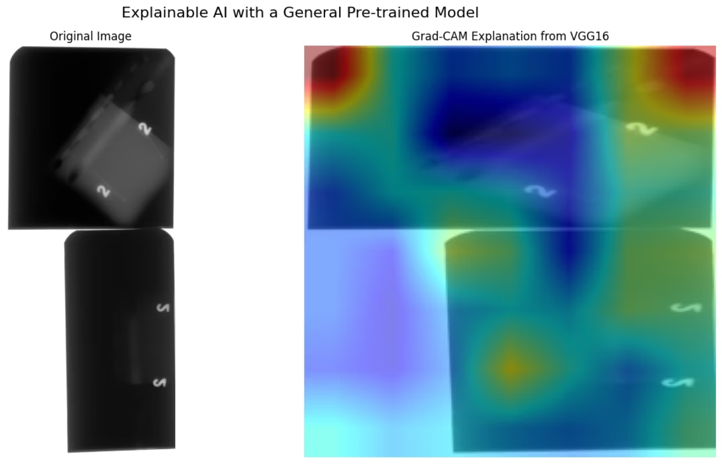
Technical Execution
Visualizing Explainability: Sample Output
This example demonstrates our system's comprehensive output, combining precise defect segmentation with an XAI heatmap for transparent and auditable weld inspection.
The visualization showcases two key components: the original X-ray image, and the segmented mask with the Grad-CAM heatmap. This multi-faceted output provides human inspectors with the necessary visual evidence to understand not only what defects were found, but also why the AI model made its decision.

